Slide 1
LIPID METABOLISM
LIPID TRANSPORT IN THE BLOOD
FATTY ACID METABOLISM

Slide 2
LIPID TRANSPORT IN THE BLOOD
To transport through the blood water-insoluble lipids from one tissue to another special transport forms exist — lipoproteins. There are 5 classes of blood lipoproteins:
1. Chylomicrons;
2. VLDL (Very Low Density Lipoproteins);
3. IDL (Intermediate Density Lipoproteins);
4. LDL (Low Density Lipoproteins);
5. HDL (High Density Lipoproteins).

Slide 3
The general structure of lipoprotein
Despite their differences in lipid and protein composition, all lipoproteins share common structural features, notably they have a spherical shape, and consist of a core of triacylglycerols or/and cholesterol esters surrounded by a single layer of phospholipids, into which a mixture of cholesterol and proteins (apoproteins) is inserted.
The phospholipids and cholesterol are oriented with their polar head groups facing outward to interact with solvent water and thus shield the hydrophobic lipids inside from the water outside. The proteins also
contribute to the formation of lipoprotein polar surface, but additionally act as cofactors for enzymes, which take part in lipoprotein metabolism.

Slide 5
Chylomicrons
Chylomicrons serve to transport triacylglycerols and cholesterol esters from the intestines to other tissues and eventually to the liver. Chylomicrons are synthesized in intestinal epithelial cells. They are the largest and least dense of the blood lipoproteins because they have the most triacylglycerol (about 90 %) and rather low content of protein. Their triacylglycerols and cholesterol are derived from the dietary lipids, and their major protein is apo B-48. Chylomicrons enter the lymphatic system and travel through the lymph into the blood.

Slide 6
VLDL, IDL, LDL
VLDL, IDL and LDL form a group of related particles that deliver endogenous triacylglycerols and cholesterol from the liver to the peripheral tissues. VLDL is synthesized in the liver. Its‘ core is formed from triacylglycerols (about 55 %) and cholesterol esters. The phospholipids, cholesterol and apoprotein apo B-100 form the coat.
In peripheral tissues, VLDL triacylglycerols are hydrolyzed by lipoprotein lipase, and VLDL is converted to IDL. Most of IDL return to the liver, bind to apo E receptors, undergo endocytosis and lysosomal degradation.
LDL is regarded as the vehicle delivering cholesterol to the peripheral tissues.

Slide 7
HDL
HDL is synthesized by the liver and released into the blood as disc-shaped particles. HDL takes cholesterol from the peripheral tissues and transports it back to the liver.

Slide 8
FATTY ACID METABOLISM
In the cells fatty acids mostly are used for 1) synthesis of structural lipids (phospholipids, glycolipids);
2) energy production;
3) storage as triacylglycerols.

Slide 9
LIPID STORAGE AND MOBILIZATION IN THE ADIPOSE TISSUE
Lipids are stored in the adipose tissue as triacylglycerols. Synthesis of triacylglycerols in
adipocytes occurs by the glycerophosphate pathway, which requires activated fatty acids (fatty
acyl-CoA) and glycerol 3-phosphate. Since adipose tissue lacks glycerol kinase, dihydroxyacetone
phosphate (DHAP, intermediate of glycolysis) serves as a source of glycerol moiety.

Slide 10
Lipogenesis in the adipose tissue is stimulated in the well-fed state, and is strongly favoured by high-carbohydrate diet. Insulin causes activation of the key regulatory enzymes of the pathways, involved in lipogenesis (glycolysis, oxidative decarboxylation of pyruvate, pentose phosphate pathway, biosynthesis of fatty acids), as well as stimulates glucose and fatty acid delivery from the blood to adipocytes.

Slide 11
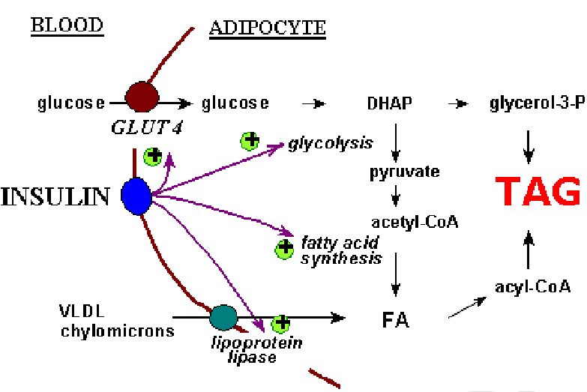
Effects of insulin on lipogenesis

Slide 12
In the fasting state, lipolysis occurs in the adipose tissue. Hormone-sensitive lipase hydrolyzes triacylglycerols, free fatty acids and glycerol are released. Fatty acids are carried on albumins through the blood to tissues such as muscle, liver or kidney, where they are oxidized for energy. Glycerol can be used by the liver as a source of carbon for gluconeogenesis.
Hormone-sensitive lipase becomes active being phosphorylated by the mechanism that involves adenilate cyclase, cAMP and protein kinase A. Glucagon, epinephrine, and other hormones cause activation of adenilate cyclase, and thus promote lipolysis under different conditions.

Slide 13
BETA OXIDATION OF FATTY ACIDS
This process is known as beta oxidation, because
the oxidation and splitting of two carbon units occur at the beta-carbon atom. The oxidation of the hydrocarbon chain occurs by a sequential cleavage of two carbon atoms.

Slide 14
Steps of beta oxidation of fatty acids
Step 1: Activation of fatty acids
Step 2: Transport of fatty acids to mitochondria through carnithine acyltransferase
Step 3: Beta oxidation of fatty acids.

Slide 15
Step 1: Activation of Fatty Acids
Fatty acids are activated to their co-enzyme A
(CoA) derivative. This activation is taking place in
cytoplasm. ATP is hydrolysed to AMP and PPi
and the energy from hydrolysis of PPi drives the
reaction forward. Thus two high energy bonds
are utilised in this reaction.
The enzyme is a thiokinase or fatty acyl CoA
synthetase

Slide 16
Step 2: Transport of fatty acids to mitochondria
Long-chain acyl-CoA, formed in the cytosol, cannot pass through the inner mitochondrial membrane. Fatty acyl-CoA is transported to mitochondria via a special transfer system — carnitine-acyltransferase (CAT).
In the outer mitochondrial membrane, acyl-CoA reacts with carnitine, forming acyl-carnitine, which passes through the translocase, located in the inner mitochondrial membrane, and re-forms acylCoA on the matrix side. Thus acyl-CoA gains access to the mitochondrial system of β-oxidation enzymes.
The outer membrane contains CAT I, the inner membrane contains translocase (T) and CAT II

Slide 17
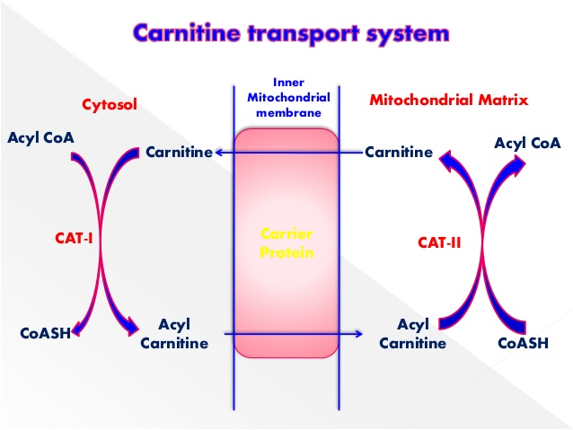

Slide 18
Beta oxidation of fatty acids
The next 4 reactions are sequentially repeated for complete oxidation of fatty acids. After one round of four metabolic steps, one acetyl CoA unit is split off and acyl CoA with 2 carbon atoms less is generated. This would undergo the same series of reactions again until the fatty acid is completely oxidised.

Slide 19
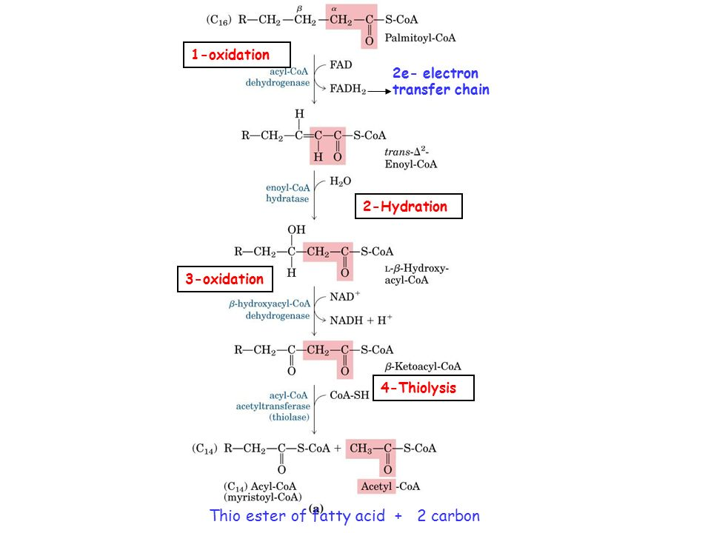

Slide 20
The pathway produces a large amount of ATP
For example, the complete oxidation of palmitic acid (C16) yields 106 ATP:
80 ATP are produced as a result of oxidation of 8 acetyl-CoA in the TCA cycle (each acetylCoA gives rise to 10 ATP);
28 ATP are produced as a result of electron transport from FADH₂ and NADHH⁺ via the respiratory chain (reduced coenzymes are generated in each turn of β-oxidation, producing 4 ATP; palmitate will be broken down during 7 turns);
2 ATP must be subtracted from the total amount of 108 ATP — that is the cost of the initial activation of the fatty acid.

Slide 21
Regulation of β-oxidation
Fatty acid oxidation is regulated by the mechanisms that control oxidative phosphorylation — mostly by the demand for ATP. [Acetyl-CoA]/[Acyl-CoA], [NADH]/[NAD⁺] and [FADH₂]/[FAD] ratios are of importance too. Carnitine-acyltransferase I located in the outer mitochondrial membrane is inhibited by malonyl-CoA, an intermediate in fatty acid synthesis. Therefore, when fatty acids are being synthesized in the cytosol, malonyl-CoA inhibits their transport into mitochondria, and, thus, prevents their immediate degradation.

Slide 22
FATTY ACID BIOSYNTHESIS
Acetyl-CoA, derived from glucose or other sources, serves as precursor for fatty acid biosynthesis. The pathway occurs in the cytoplasm, and acetyl-CoA is carried out of the mitochondrion by a citrate shuttle: acetyl-CoA and oxaloacetate condense to form citrate, which can cross the mitochondrial membrane. In the cytoplasm, citrate lyase cleaves citrate to acetyl-CoA (used for biosynthesis of fatty acids) and oxaloacetate (returned to the mitochondria after conversion to malate or pyruvate). Pay attention to cytosolic NADP+-dependent malate dehydrogenase (or malic enzyme). Malic enzyme, together with oxidative reactions of pentose phosphate pathway of glucose metabolism, supplies the reactions of fatty acid biosynthesis with reduced equivalents (NADPHH⁺).

Slide 23
Transfer of acetyl-CoA from the mitochondrion to the cytoplasm (citrate shuttle)

Slide 24
Biosynthesis of fatty acids occurs on the fatty acid synthase complex — a multienzyme complex that incorporates an acyl carrier protein (ACP) and seven catalytic domains. An active enzyme is a dimer of two identical subunits. ACP contains a phosphopantetheine residue, derived from the vitamin pantothenic acid, as found in coenzyme A, thus, can form a thioester linkage with acyl groups. ACP operates as a ― «swinging arm» that carries the acyl through the multiple activities of the fatty acid synthase complex.

Slide 25
Initially, acetyl-CoA is converted to malonyl-CoA by acetyl-CoA carboxylase. The reaction requires biotin as cofactor and ATP, and is a key reaction of the pathway:
The malonyl-CoA produced in this reaction, along with acetyl-CoA, provide substrates for the fatty acid synthase complex. First, to start reactions on the complex, acetyl and malonyl moieties are passed to ACP, with following transfer of the priming acetyl group to the enzyme cysteinyl residue. Like in fatty acid oxidation, one turn of fatty acid synthesis involves 4 enzymatic activities.

Slide 26
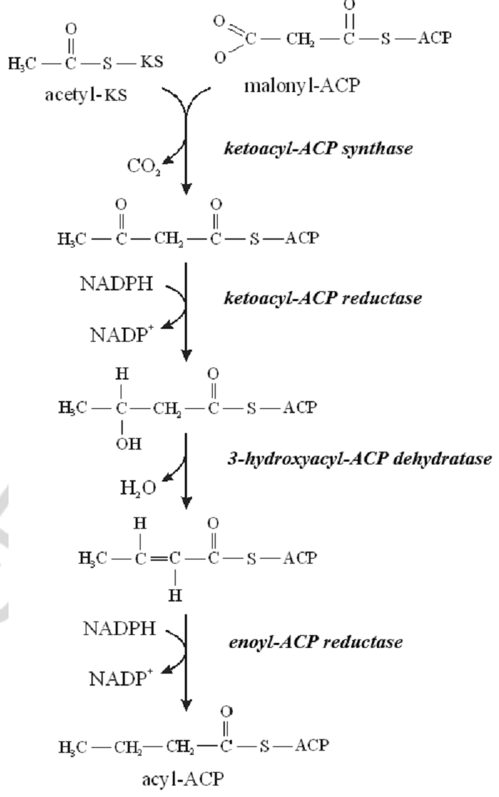

Slide 27
Regulation of fatty acid biosynthesis
The key regulatory enzyme of the pathway is acetyl-CoA carboxylase. It is activated by dephosphorylation (insulin) and by citrate, inhibited by phosphorylation (glucagon) and by acyl-CoA. A number of enzymes involved in biosynthesis of fatty acids (citrate lyase, acetyl -CoA carboxylase, enzymes of fatty acid synthase complex) are induced by insulin.

