Slide 1
Glaucoma
The Department of Ophthalmology
Orenburg State Medical University
Lecturer:
Iserkepova A.M.
Orenburg, 2020

Slide 2
The main cause of irreversible blindness all over the world
Glaucoma all over the world suffer:
up to 105 million people; 5,2 million people have blindness in both eyes, every minute is blinded one sick person, but every 10 minutes – 1 child.
In Russia glaucoma - the main cause of vision impairment (28%).
Today in Russia more 850 000 patients with glaucoma.
Notes:
one hundred five; eight hundred fifty thousand

Slide 3
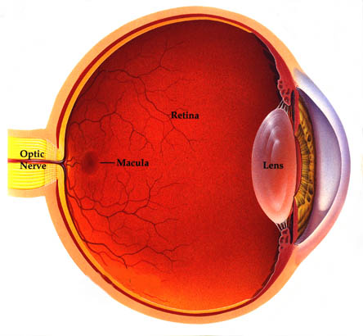
The main cause of irreversible blindness all over the world
Glaucoma – group of chronic diseases, characterized by a constant or periodic increase in intraocular pressure, leading to a narrowing of the visual fields, reduse visual acuity, atrophic changes of the optic nerve.
hydrodynamics
PRODUCTION (5%)
OUTFLOW (95%)
Notes:
hydrodynamics of the eye is affected

Slide 4
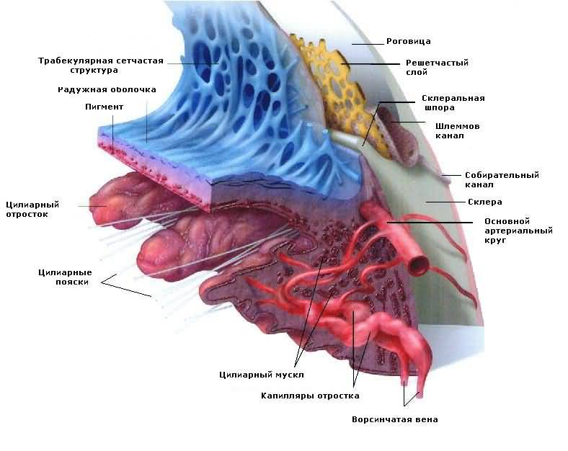
Physiology of ophthalmotonus
Intraocular fluid – ultrafiltrate of blood plasma
Function – nutrition of avascular structures
– conducting and refraction of light
– maintenance of ophthalmotonus
Production – β-cells of the
pigment epithelium
the process part of the ciliary body →
back camera → pupil →
front camera →
angle of the front camera
Notes:
Arrives - поступает, through – через;

Slide 5
Paths of outflow of intraocular fluid
– the front path(80%):
trabecula → Helmet canal (scleral sinus) → collector canals of the first and second order→ water veins ( of Usher) → veins of orbit
– back path (20%):
suprachoroidal spase
perineural (envelope nervus opticus)

Slide 6
Intraocular fluid – transparent and colorless, its density 1,005 – 1,007, refractive index– 1,33.
Amount of watery moisture in human does not exceed 0,2 – 0, 5 ml.
Watery moisture contains salts, ascorbic acid, microelements.

Slide 7
Classification of glaucoma
Primary
Secondary
Combined

Slide 8
Classification of primary glaucoma
Forms Stages Level of VGD Stabilization of functions
Open – angle I. Initial a. Normal
(up to 26 mm Hg)
Closed - angle II. Developed b. Moderately Stabilized
elevated
Mixed III. Far - reaching (27- 32 mm Hg)
c. High Unstabilized
IV. Terminal (33 mm Hg
and higher)
Acute attack of angle – closure glaucoma
Suspicion of glaucoma
Example: OU – Open - angle II b unstabilized glaucoma
Notes:
emit – выделяют, millimeter of mercury – мм.рт.ст.

Slide 9
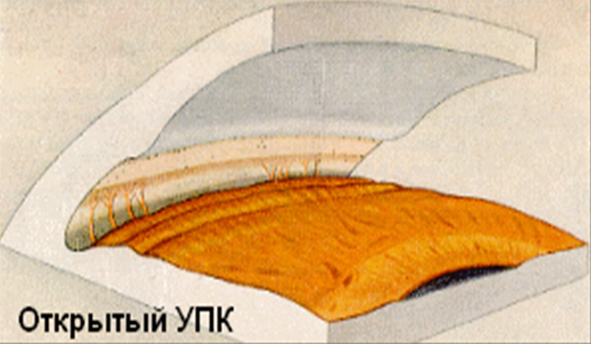
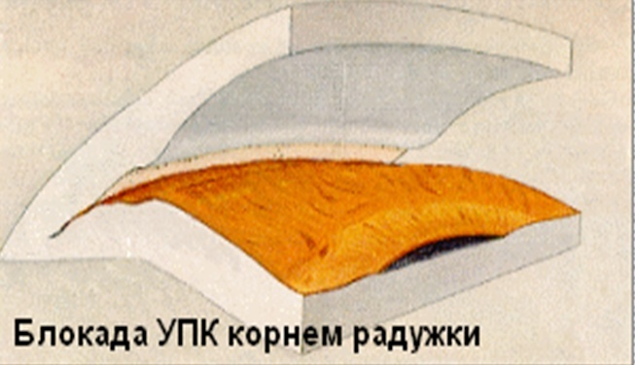
Primary glaucoma
Occurs after 40 years
Always a two – way process
Malignant course (irreversible blindness)
Features of the structure of the angle of the front chamber

Slide 10
Risk factors in glaucoma
individual anatomy and topography of the drainage system;
individual anatomy and topography of the optic nerve and vascular structures of the eye;
hypotension;
hypothyroid state;
thin central part of the cornea;
heredity;
age over 40 years;
high myopia.
Нестеров А.П. 2005

Slide 11
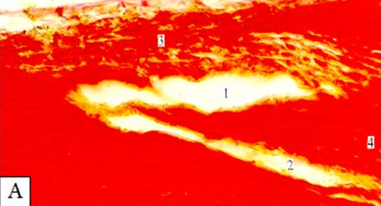
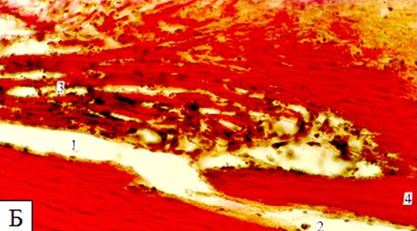
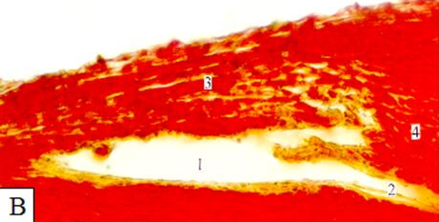
Primary open - angle glaucoma
Etiology
1. Anatomical features of the eye: weak development scleral spurs and ciliary muscle, back attachment fibers of this muscle to the sclera, forward position of the helmet channel and other.
Differences in the flow of water veins from the venous sinus of the sclera:
А- front; Б-average; В-rear. Van Gieson coloring. Microphotographs.
1-helmet canal; 2-water vein; 3-trabecular mesh; 4-sclera. I.I. Kagan, V.N. Kanyukov, 2015.

Slide 12
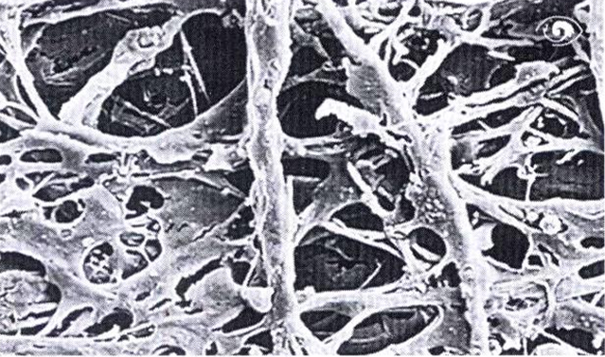
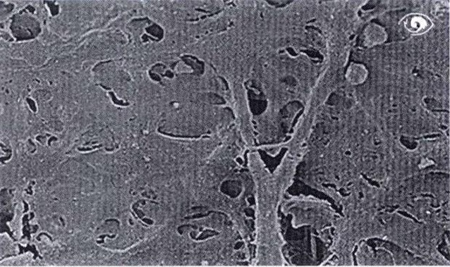
2. Age – related dystrophic and degeneratuve changes in the trabecular apparatus, iris and ciliary body.
3. High sensititivity inraocular pressure to corticosteroids, genetically.
4. Genetic predisposition to primary open – angle glaucoma.

Slide 13
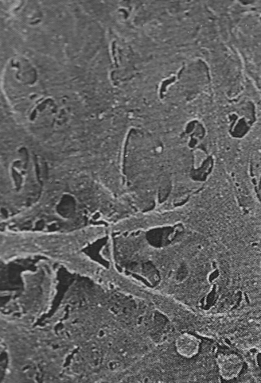
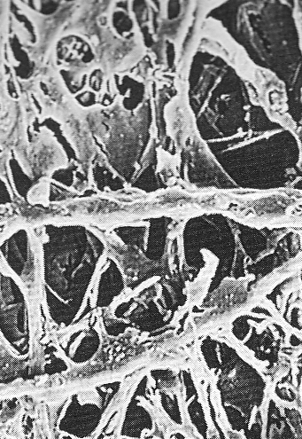
trabecula
normal
in glaucoma

Slide 14
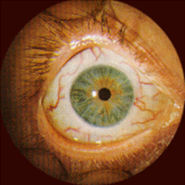
Clinic.
Complaints of the patient: subjective symptoms of the disease or completely absent, or mild.
Objectively.
Biomicroscopically: microvascular disorders in conjunctiva and sclera (uneven narrowing of arterioles and widening of venules, microaneurysms, small hemorrages). Often a symptom of cobra – enlargement and fossilization of the anterior ciliary artery.

Slide 15
Symptom complex of glaucoma
1. Instability and increased intraocular pressure.
2. Impairment of visual functions (peripheral vision impairment, visual acuity reduction).
3. Atrophy of the optic nerve (blindness).

Slide 16
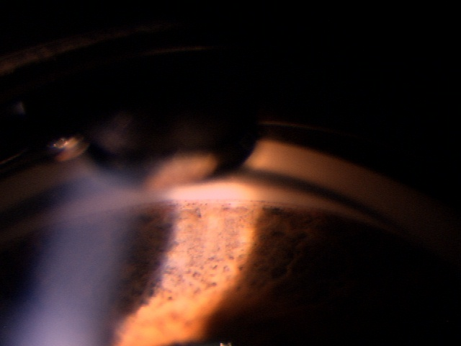
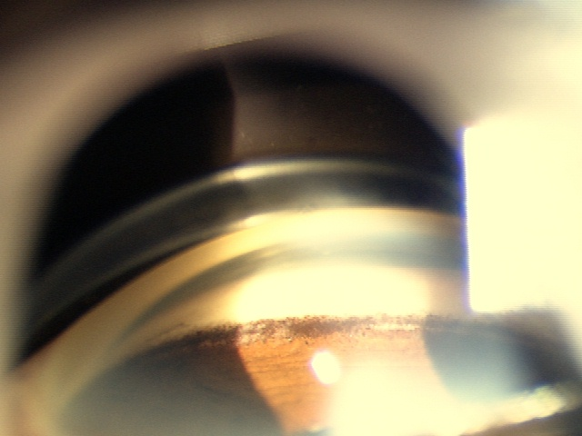
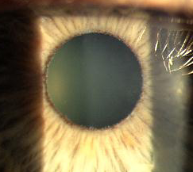
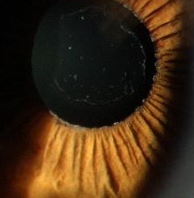
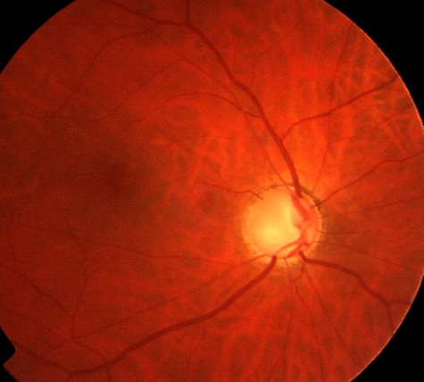
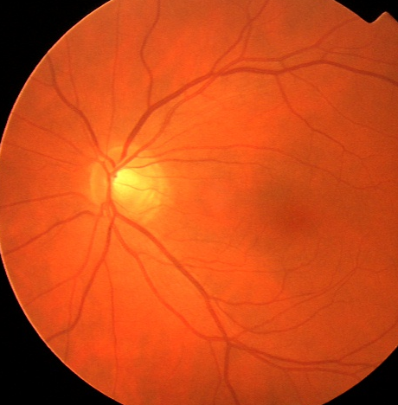
Diagnostics
Complaints and anamnesis;
The study of visual acuity;
Measurement of intraocular pressure;
Biomicroscopy;
Gonioscopy;
Ophthalmoscopy;
The static computer perimetry screening programs.
One of the main criteria - Asymmetry!

Slide 17
Intraocular pressure
Intraocular pressure –true and tonometric
Norms of intraocular pressure:
True: from 9 to 21 mm Hg (average 14 – 16 mm Hg)
- Tonometric: from 18 to 26 mm Hg (tonometer Maklakova 10 grams)

Slide 18
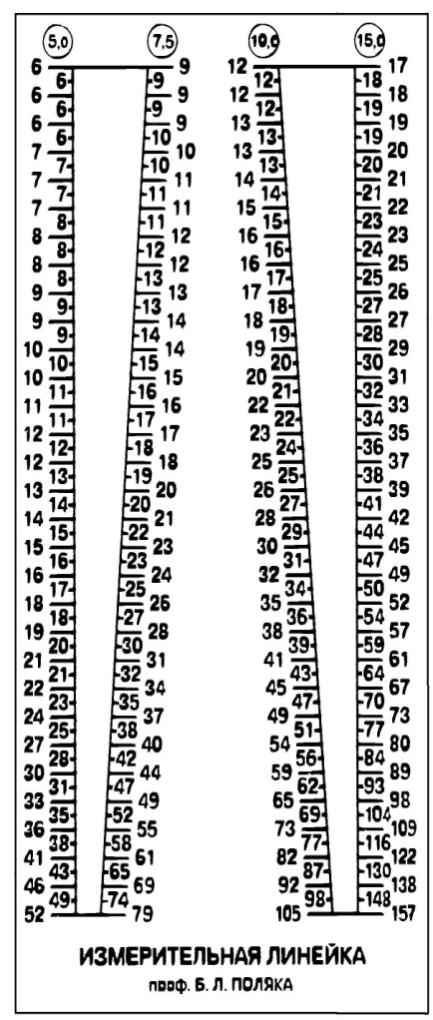
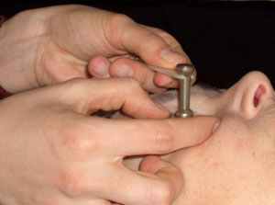
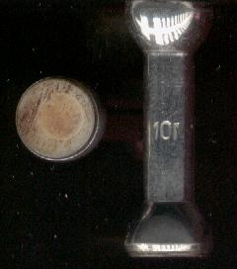
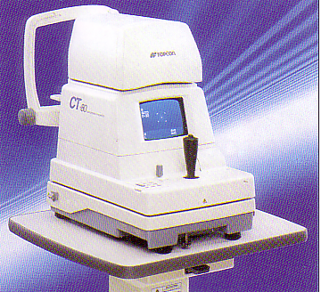
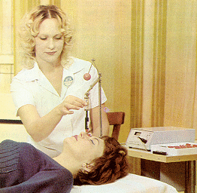
Intraocular pressure and his research
N = 18 - 26 mm. Hg
(for Maklakov tonometer)
Study – palpatory
– tonometry
– tonography
– elastotonometry
Daily fluctuations
up to 5 mm Hg
The difference between the eyes
up to 3 mm Hg

Slide 19
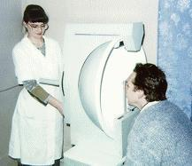
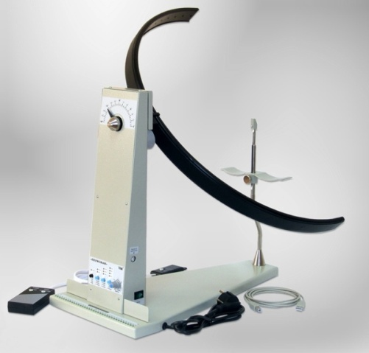
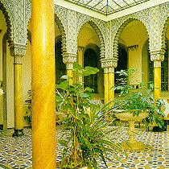

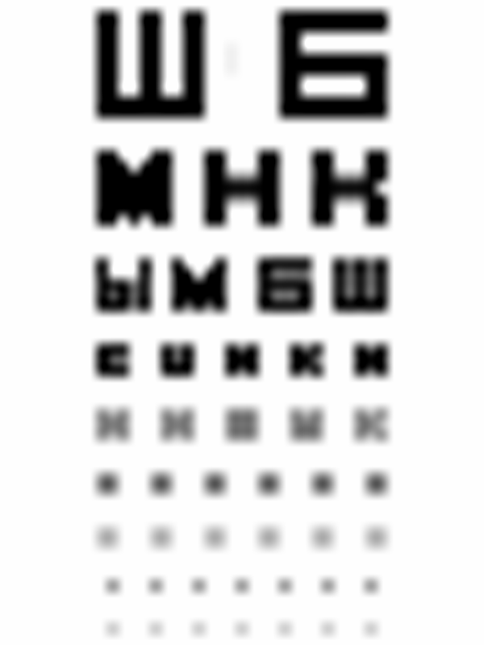
Fielgd examination (stage of glaucoma)
I
OS OD
55 55
II
75 55 55 75
90 60 60 90
III
90 50 50 90
60 60
15°
The sum of degrees of 8 meridians is not less than 530
15°
5°
Notes:
five hundred thirty – 530; at the first stage, narrowing of the visual fields by 5 degrees; at the second;
at the third

Slide 20
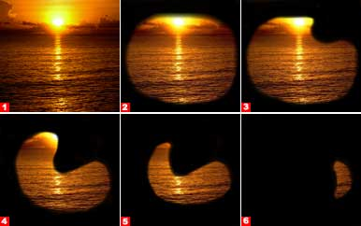
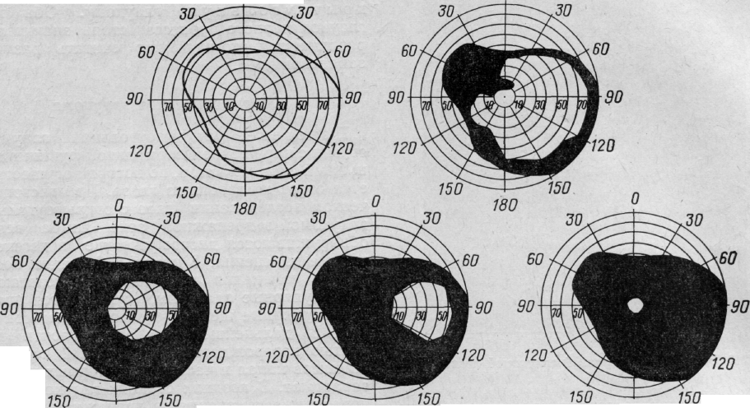
Dynamics of narrowing of fields of vision by stages
Stage I (initial) - boundaries of the visual field are normal, but there are small changes in the paracentral parts of the visual field.
Stage II (developed) - changes the field of view expressed in the paracentral section in conjunction with its restriction from 10 to 50 ° in the upper- and / or the lower nasal segments.
Stage III (far-advanced) - the boundary of the field of view concentric narrowed, and in one or more segments is less than 15 ° from the point of fixation.
Stage IV (terminal) - complete loss of vision or saving light perception with the wrong projection. Sometimes it retained a small island in the temporal visual field sector.

Slide 21
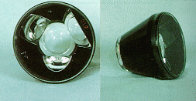
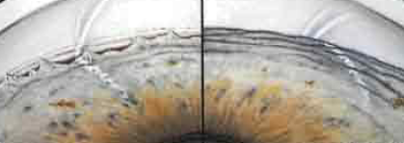
Gonioscopy (forms of glaucoma)
Difficulty in outflow the trabecular network as a result of dystrophic processes.
Blockade of the anterior chamber angle by the root of the iris.
Blockade of the anterior chamber angle by mesodermal tissue.
Notes:
necessary to determine the form..

Slide 22
Characterization of glaucoma stages
I – Primary stage. Glaucomatous excavation of the optic nerve not, changes in the field of view (concentric narrowing of the field of view up to 5 degrees from the periphery). Increase in the size of a blind spot.
II – Developed stage. Persistent narrowing of the field of vision (more than 10 degrees from the bow or up to 15 degrees from the periphery). Glaucomatous excavation of the optic nerve.
III – Far – reaching stage. A narrowing of the field of vision is typical (less than 15 degrees from the fixation point), edge excavation of the optic nerve, gray disc optic nerve.
IV – Terminal stage. Loss of object vision (presence of light perception) or complete loss of visual function – blindness (amaurosis).

Slide 23
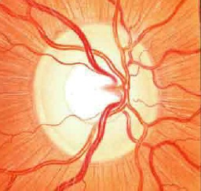
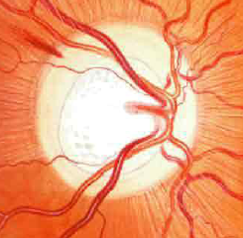
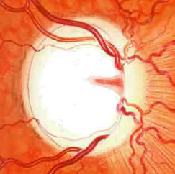
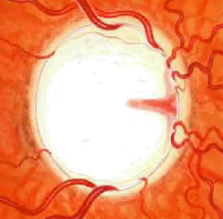
Stage of glaukoma
Whell excavation optic nerve => atrophy optic nerve
I
II
III
IV
Notes:
glaucoma excavation appears in the second; optic disc color turns gray

Slide 24
Conservative treatment of primary glaucoma
1. Means that improve the outflow
Myiotics – open the angle of the front chamber, stretch the trabeculae
а) Cholinomimetics (Pilocarpine 1% - 6% up to 4 times a day)
b) Anticholinesterase (Phosphacol, Armine)
Prostaglandins – improve uveal outflow (Travatane, Latanoprost)
2. Means that reduse the production of intraocular fluid
β-adrenoblockers (Timolol, Arutimol 0,5% 2 times a day)
Ingibitors of carbonic anhydrase - Diacarbus (Acetazolamide);
Trusopt 2% (Dorzolamide); Azopt 1% (Brenzolamide)
3. Diuretics - Furosemide (Lasix), Hypothiazide, Mannitol

Slide 25
Only 34% of patients comply with the instillation regime
Reasons for not serious attitude to treatment:
apparent absence of complaints
misunderstanding of the purpose of regular treatment
adverse drug effects (hyperemia, pruritus, eyelash growth)
technical problems of instillation

Slide 26
Side effects of cholinomimetics
Local
Irritation, burning, lacrimation
Miosis (pupillary block)
Hemeralopia
Spasm of accomodation
Headache and pain in the brow
Increase in vascular permeability
Are common
Spasmodic pains in the intestine
Diarrhea
Bronchoconstriction
Notes:
26

Slide 27
– Outflow improving
1. Laser goniopuncture, laser trabeculoplasty
2. Fistulizing operations
(deep subscleral sclerectomy with basal iridectomy)
– Reducing products
(cryopexy of the ciliary body)
– Enucleation (terminal painful glaucoma)
Operative treatment of primary glaucoma

Slide 28
Surgical treatment of glaucoma
Indications for surgery:
- with insufficient effectiveness of drug therapy
- in the initial stage of the disease, when there are no secondary changes in the angle of the anterior chamber and drainage system of the eye.
The choice of surgical treatment is carried out after diagnosis of the level of violation of retention of intraocular fluid.
In trabecular hypertension – trabeculotomy.
With intrascleral hypertension – sinusotomy.
When combined – sinostrabecllectomy.

Slide 29
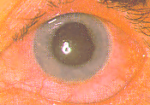
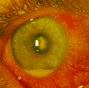
Differential diagnostics
Bout of glaucoma
Acute iridocyclitis
Complaints about iridescent circles when looking at the light, visual acuity reduction
Cornea rough, muddy
(endothelial edema and stroma)
Irradiating pain
Congestive injection
Front camera is small or missing
Midriasis
Hypertension (up to 60 mm.Hg.)
Edema of the optic nerve
There are no rainbow circles
Cornea is transparent
(on endothelium precipitates)
Pain in the eye prevails
Mixed injection
Anterior chamber is medium
Miosis (due to edema of the iris)
Ophthalmotonus normal

Slide 30
Treatment of an acute attack of an angle – closure glaucoma
Instillations of Pilocarpine 1-6%
1-st hour – after 15 minutes
2-nd hour – in 30 minutes
further – hourly
Dehydration – forced diuresis
– laxatives (osmotherapy)
Distracting therapy
– hot food baths
– mustard plasters on lower legs and forearms
In the absence of effect more than 12 hours – surgical treatment:
– complete iridectomy
– deep subscleral sclerectomy

Slide 31
Suspicion of glaucoma
Up to 5 years
Tonometry:
1 time per month
Perimetry:
1 time in 3 months
Suspicion:
Low vision loss
Recurrent headaches
Intraocular pressure 25-26 mm Hg
Identification of – in – patient examination:
Daiy tonometry 3 – 4 days
2 – hour tonometry
Perimetry, ophtalmoscopy, gonioscopy
Load tests: - water - drinking
- dark
- atropine
- sclero - compression
Discharge test: - pilocarpine

Slide 32
Food is normal as in a healthy person.
Coffee / tea
Within 1 hour after consuming coffee or tea, a moderate increase in intraocular pressure, but this effect is so minimal that no patient with glaucoma never spoke of these drinks.
A patient with glaucoma should not limit himself to using liquid, but it should be used evenly throughout the day.
Sauna
The sauna can also be enjoyed to the fullest without any special concerns. Change in intraocular pressure occurs in patients with glaucoma as well asin healthy people: in the sauna it is redused, and then restored to its original level after about 1 hour.
Reading
Can be read in bright light (lamp 100 – 150 watts under the shade), the light should be placed on the left.
Every hour you need to take a break for 10 – 15 minutes.

Slide 33
Ophthalmohypertension
No violation of visual functions
Essential (symmetric)
Symptomatic (other pathology)
- uveal + dystrophic uveapatiya Fuchs
- toxic
- diencephalic (Itsenko - Kushing, hypothyroidism)
- medicamentous (corticosteroids)
Glaukomotsiklitichesky crisis
Posner - shlossmana (etiology is unsettled)

Slide 34
Secondary glaucoma
Fakogennaya- fakomorphic
- fakolytic
- fakotopical
Uveal (postinflammatory)
Neovascular (rubeosis)
Neoplastic
Postthrombotic (trombosis of the central retinal vein)
Posttraumatic – penetrating wound
- contusion
- burns

Slide 35
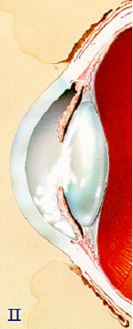
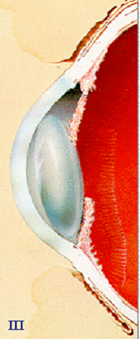
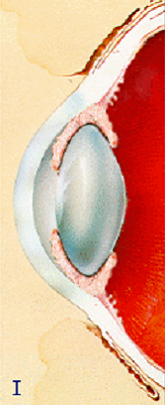
Fakogennye glaucoma
Notes:
treatment option is cataract extraction

Slide 36
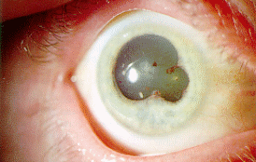
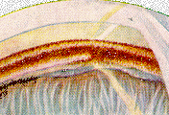
Postinflammatory glaucoma
Notes:
synechia (adhesions) exudate increase ВГД

Slide 37
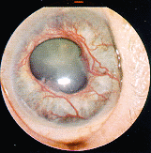
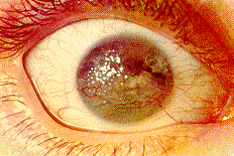
Neovascular glaucoma
Notes:
angiogenesis inhibitors are used for treatment

Slide 38
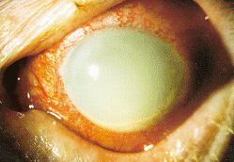
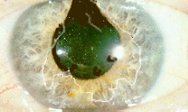
Posttraumatic glaucoma
Notes:
corneal opacity

Slide 39
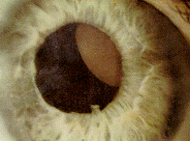
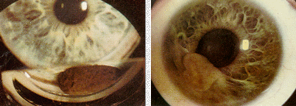
Neoplastic glaucoma
Notes:
neoplasms of the iris and ciliary body, the treatment is to remove the neoplasm

Slide 40
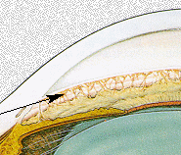
Congenital glaucoma
Anomaly of the anterior chamber or the drainage angle
Intrauterine - infection during pregnancy
(rubella, flu, parotitis, toxoplasmosis)
- endocrine disorders
- hypo and avitominoz
- intoxication
- hypoxia
- ionizing radiation
Hereditary
Classification(Е.I. Кovalevskii, E.G. Sidorov)
1. Simple- only with anomalies of development of drainage system
2. With co - morbidities - aniridia, iris coloboma, Peters anomaly, Rieger, Fuchs ana others
3. With associated local and general pathology- Sterzh syndromes Weber – Krabbe, Low, Leber, neurofibromatosis.

Slide 41
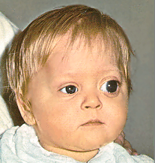

Congenital glaucoma
Objectively:
gidroftalm (buphthalmos)
simptom blue sclera
corneal increase
corneal cracks
corneal edema
dystrophy until ulcers
staphylomas sclera
Subbjectively :
photophobia
lacrimation
anxiety
loss of sleep

Slide 42



Treatment of congenital glaucoma
ONLY OPERATIVE !!!
In the first months of life – as soon as the anesthesia allowed neonatologists and anesthesiologists
goniotomiya, trabekulotomiya
goniopuncture (laser)
fistulizing operations

Slide 43

Thank you!
Notes:
43

